Slide 1
TrainUP
Online Meeting
Lesson 01 – Simple Present
Advanced

Slide 2

2 – daily routine
Daily Routine
Jobs

Slide 3
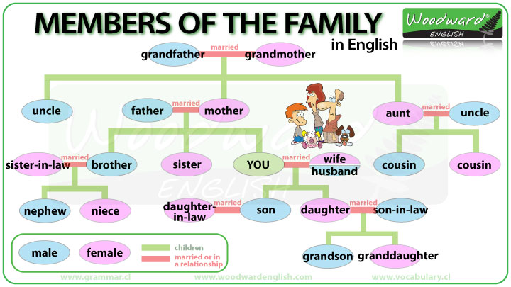
2 – daily routine
Daily Routine

Slide 4


TrainUP
Online Meeting
Lesson 01 – Simple Present

